Slide 1
Introduction
[N.G.O Website]
[Members]
-Thân Tâm Như
- Trương Võ Bảo Hân
- Lê Thành Lợi
- Phạm Ngọc Hải
Date… Month… Year …...

Slide 2
Content
Introduction
Actual requirements
Requirements of the project
Deployment diagram
Test result
Conclusion and development
Task list

Slide 3
Introduction - Actual requirements
The website should contain a menu through which the different topics can be fetched out with an ease.
The menu should contain the following: Home Page, About Us,Feedback, Causes,Partner,Donate,Register

Slide 4
Introduction - Requirements of the project
Functional
- Admin Page : User,Partner,Causes,About Us,Feedback
… - User Page : Home,Donate,Register, Login
Non-functional
- About Us Page
….
Notes:
Non-functional (how the system works)
Functional (what the system should do)

Slide 5
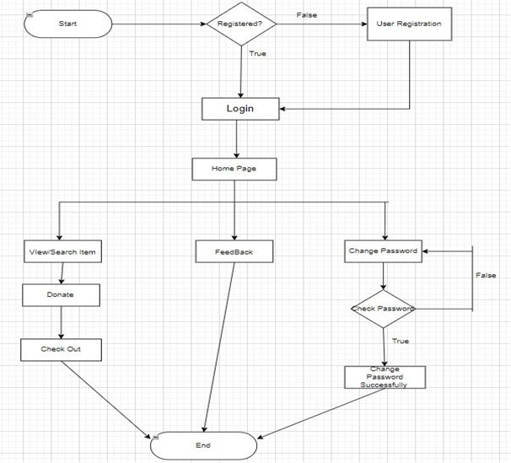
Introduction - Deployment diagram

Slide 6
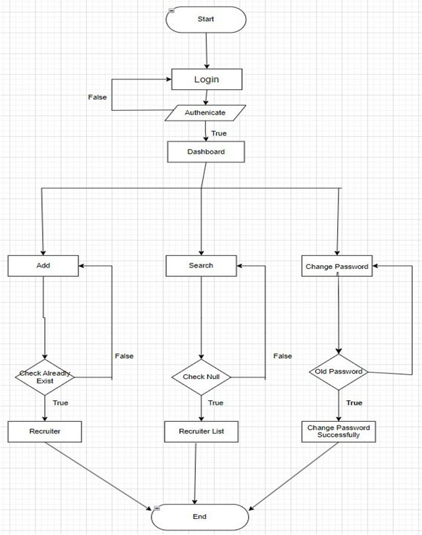
Test Result [1-n]

Slide 7
Test Result [2-n]

Slide 8
Conclusion

Slide 9
Development

Slide 10
Task List

Slide 11

Thank You

Slide 12
Reference

